Slide 1
Increase Revenue Generation in Amsterdam
Mncedisi Mncwabe October 2021
**Dataset accessed from Maven Analytics datasets

Slide 2
Overview
Determine which neighborhoods and property types make the most revenue in Amsterdam to create targeted campaigns which increase properties in those neighborhoods to increase revenue.
Hospitality terms used
Revenue – Money paid by guests
Occupancy – The number of bookings compared to capacity
Average daily rate (ADR) – Revenue compared to the number of bookings
Revenue parity (RevPAR) – Revenue compared to capacity
Dataset covers 2019

Slide 3
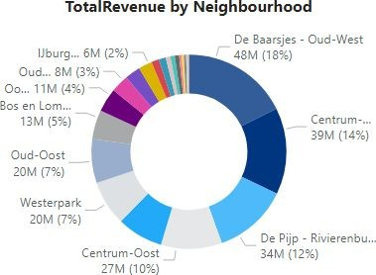
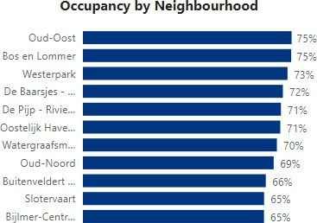
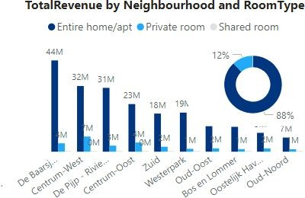
Which neighbourhoods and room types make the most revenue & have the highest occupancy
De Baarsjes Oud – West, Centrum - West and De Pijp make the most revenue at a combined 44% of total revenue.
Oud Oost and Bos en Lommer both have the highest occupancy at over 75%
88% of revenue comes from entire homes/apartments

Slide 4
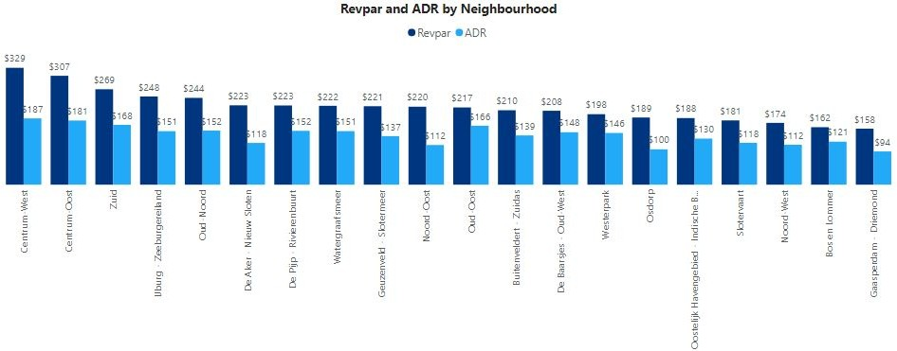
Neighbourhoods with the highest revenue generating indicators
Centrum West, Centrum Oost and Zuid have the highest RevPAR at over $250
Centrum West, Centrum Oost, Zuid and Oud Oost have the highest ADR at over $160
Both of these measures indicate that they have the highest revenue generation by room

Slide 5
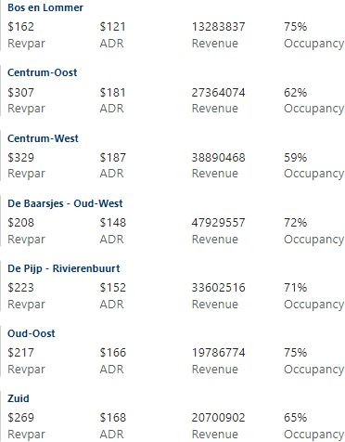
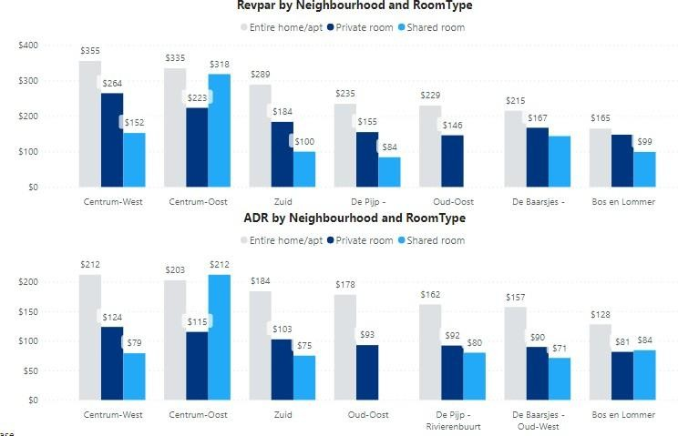
Which neighbourhoods and room types should be targeted?
These are the neighbourhoods that should be targeted, they each have a revenue indicator in the 90th percentile
Focus efforts increasing volumes of entire homes/apartments as they account for 75% of total revenue

Slide 6
Conclusion
De Baarsjes Oud – West, Centrum - West and De Pijp make the most revenue at a combined 44% of total revenue.
Oud Oost and Bos en Lommer both have the highest occupancy at over 75%
88% of revenue comes from entire homes/apartments
Centrum West, Centrum Oost and Zuid have the highest RevPAR at over $250
Centrum West, Centrum Oost, Zuid and Oud Oost have the highest ADR at over $160
Both ADR and RevPAR indicate that they have the highest revenue generation by room
The neighbourhoods that should be targeted are below, they each have a revenue indicator in the 90th percentile
Centrum-West, Centrum-Oost, Zuid, De Pijp – Rivierenbuurt, Oud-Oost, De Baarsjes - Oud-West, Bos en
Lommer
Focus the campaign on increasing volumes of entire homes/apartments as they account for 75% of total revenue
Increasing the properties by 10% in the 7 neighborhoods identified would increase their revenue generation by 6% and a 20% increase would increase it by 12%

Slide 7

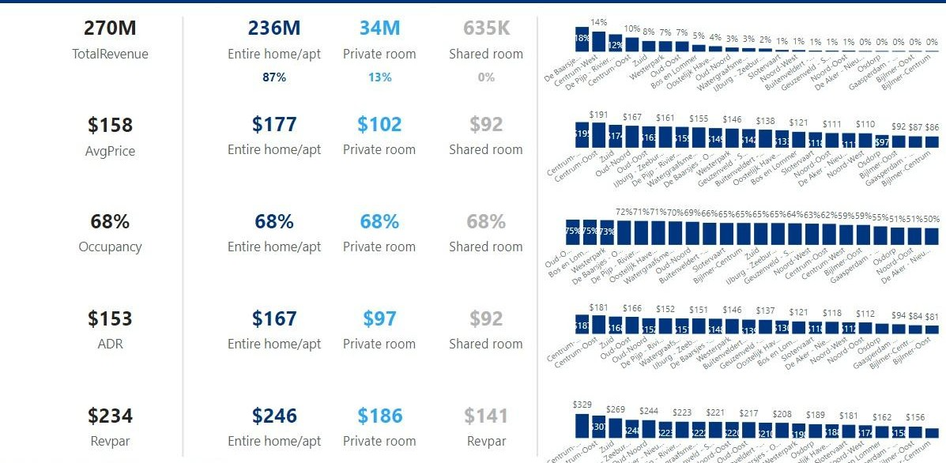
Reporting example using Google Data Studio to monitor progress

Slide 8
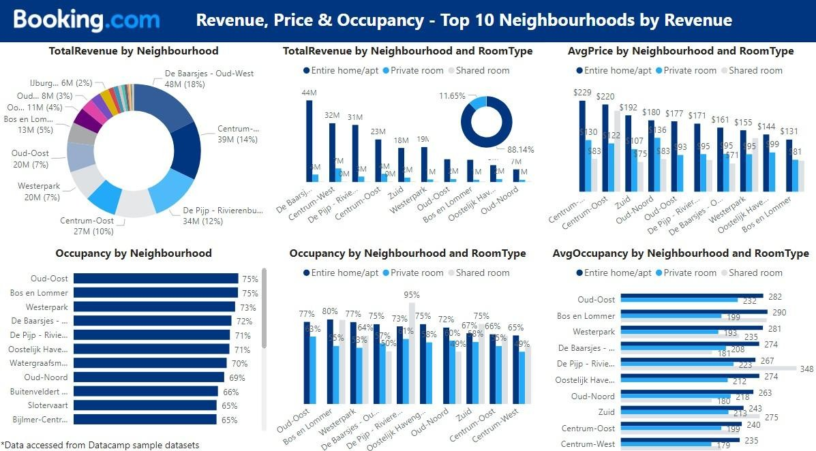

Reporting example using Google Data Studio to monitor progress

Slide 9
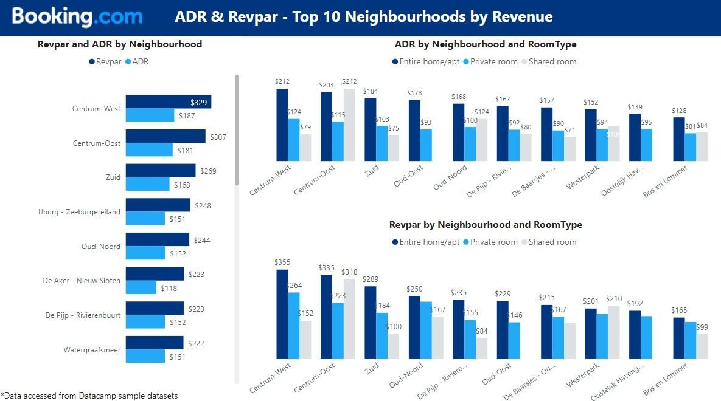

Reporting example using Google Data Studio to monitor progress

